Slide 1

CT-216 PROJECT
Introduction to Communication Systems
Prof. Yash Vasavada
Group - 3
Lab Group 5-6

Slide 2


Polar Codes

Slide 3
Honor code
We as a group, declare that :
The work that we are presenting is our own work.
We have not copied the work (Python code, results, etc.)
that someone else has done.
Wherever we have relied on an existing work that is not ours, we have provided a proper reference citation.
The concepts, understanding, and insights we will be describing are our own.
We make this pledge truthfully. We know that violation of this solemn pledge can carry grave consequences.

Slide 4



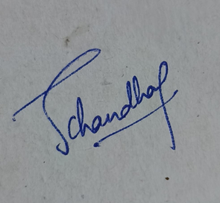



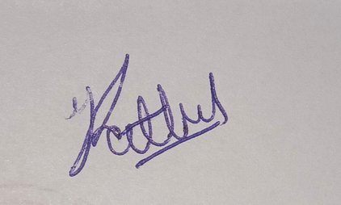
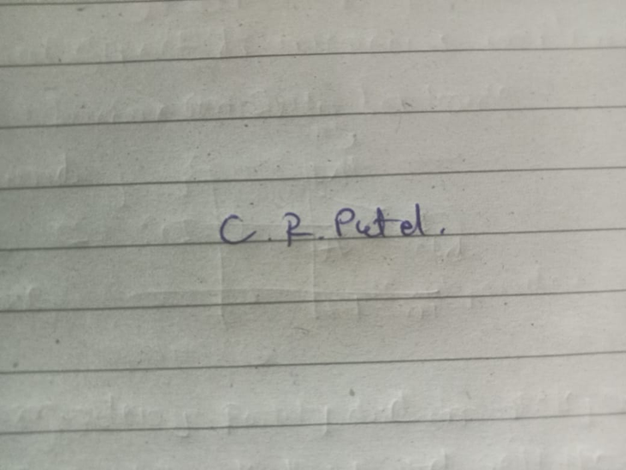
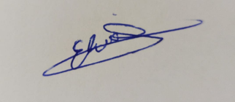
Group Members
Natansh Shah - 202201445
Devarsh Soni - 202201446
Devarshi Patel - 202201447
Vasoya Neel - 202201448
Chirag Patel-202201512
Ayush Chaudhari -202201517
Jemini Chaudhari- 202201521
Arnold Mochahari- 202201522
Yash Rathod - 202201524
Elvis Kotadiya-202201526

Slide 5


Outline
Introduction
Block Diagram
Polar Encoding
Bit Channels and Polarization
BPSK AND AWGN
Brute Force Method (Hard Decoder)
Successive Cancellation Decoder
Successive Cancellation list Decoding

Slide 6

1
Introduction
Polar codes were introduced by Erdal Arıkan in 2008
Polar codes are the first codes to reliably achieve channel capacity on binary memoryless symmetric channels through a straightforward deterministic construction process.
Encoded using Kronecker product
Decoded in sequential order
When decoded using successive cancellation decoder it splits channel into sub bits channels and on increasing input bits sub bits converge
to purely noiseless channel or noisy channel.
Therefore they are channel-polarized.
Image credit - https://lanredahunsi.com/erdal-arikan-polar-codes/

Slide 7
2
Block Diagram
Adding
CRC
Encode
BPSK +
AWGN
LIST
DECODE
CHECK
CRC
M
cwords
msg estimate
msg
cword
A
bits
K
bits
N
bits
K=A+L
(N,K) code
M : listsize

Slide 8
3
Polar Encoding
Polar Transfrom G₂
1
0
G₂=
1
1
[u1 u2]G = [u1+u2 u2]
u1
x
X1
y1
BPSK
+
AWGN
X2
y2
u2
Mapping from (u1,u2) to (X1,X2) is an invertible mapping

Slide 9
4
Binary Tree Representation
[u1 u2]G = [u1+u2 u2]
1
0
G₂=
1
1
u1
u2

Slide 10
5
Polar Transform General
Finding G matrix for general N
n
x
1
0
G₂ⁿ=
1
1
NXN
n
N=
2
u⁽ᴺ⁾= uG
N
Binary Tree Representation
depth=n
u (message bits at the leaf nodes and u⁽ᴺ⁾ encoded messsage bits at the top

Slide 11

6
Polar Transform G₄
N=4
1
0
0
0
n=log₂(4)=2
1
1
0
0
x
2
1
1
0
1
0
x
1
0
1
0
1
0
G₄=
1
1
1
1
1
1
1
4X4
1
1
1
1
u⁽ᴺ⁾= uG = [u1+u2+u3+u4 u2+u4 u3+u4 u4]
N

Slide 12
7
Binary Tree Representation G₄
[u1+u2+u3+u4 u2+u4 u3+u4 u4]
[u1+u2 u2]
[u3+u4 u4]
u1
u2
u3
u4

Slide 13
8
Bit Channels and Polarization
BPSK
+
AWGN
G
X
rᴺ
uᴺ
N
u₁
Bit Channel 1
rᴺ
u₂
rᴺ,u₁
Bit Channel 2
u₃
rᴺ,u₁,u₂
Bit Channel 3
.
.
.
.
.
u
rᴺ,u₁,u₂...u
N
Bit Channel 4
N-1
As we increase the bit size the bit channels can be polarized either
very noisless or noisy and we can order them on their confidence level.

Slide 14
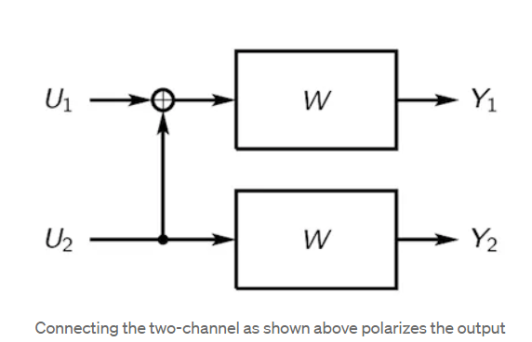
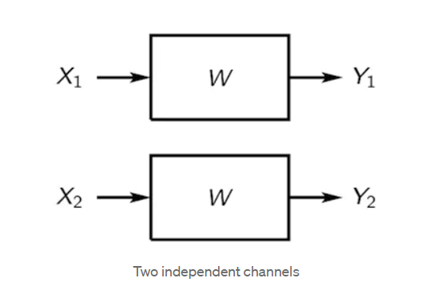
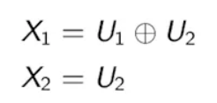
Bit Channels and Polarization
9
How can we polarize a data channel into extremal good and bad channels?
Let W is a Binary Erasure Channel (BEC)
let X is fed into W
X is unsuccessfully decoded with probability p that is BEC is able to detect that bit has been erased.
X is successfully decoded into Y probability 1-p
W⁻ : U₁ → (Y₁, Y₂)
W⁺ : U₂ →(Y₁, Y₂)
W- tries to reconstruct input received on channel through which U1 is coming.
W+ tries to reconstruct input received on channel through which U2 is coming.
Image credit - https://medium.com/5g-nr/polar-codes-703336e9f26b

Slide 15
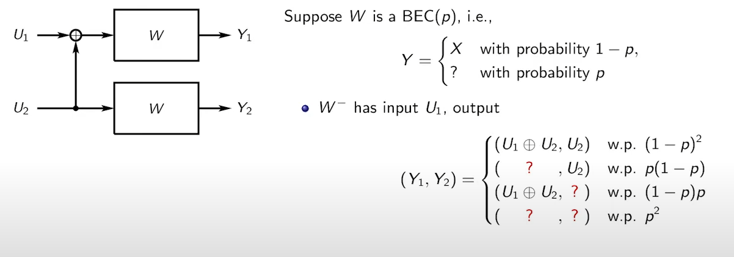
Bit Channels and Polarization
10
How can we polarize a data channel into extremal good and bad channels?
U1 can only be decoded successfully decoded with probability (1-p)²
since U1 can be extracted from U1 xor U2 and U2 is successfully decoded.
And all other cases will unsuccessfull decode U1
U1 is successfully decoded with probability (1-p)²
U1 is unsuccessfully decoded with probability p(1-p) + (1-p)p + p² =2p-p²
let succcess probability 1-p=0.8 and unsuccess probability p=0.2
W- success probability = (1-p)² =0.64
W- unsuccess probability = p(1-p) + (1-p)p + p² =2p-p²=0.36
Image credit - https://medium.com/5g-nr/polar-codes-703336e9f26b

Slide 16
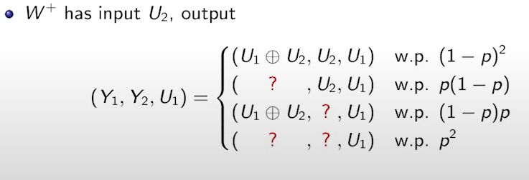
Bit Channels and Polarization
11
How can we polarize a data channel into extremal good and bad channels?
U2 can be successfully decoded in first and second case as U2 is received successfully .
In third case we have already decoded U1 and we have U1 exor U2 and therefore we can successfully decode U2 also.
In last case we can’t decode U2
U2 can be successfully decode with probability (1-p)² + p(1-p) + (1-p)p = 1-p²
U2 can be decoded unsuccessfully with probability p²
we have success probability from previous slide as 1-p = 0.8
and unsuccess probability p=0.2
W+ success probability = (1-p)² + p(1-p) + (1-p)p = 1-p² =0.96
W+ unsuccess probability = p²=0.04
As you can see that success probability is more in W+ than compared to W-.
Image credit - https://medium.com/5g-nr/polar-codes-703336e9f26b

Slide 17
12
Reliability Sequence
The reliability sequence in polar codes refers to a sequence of values assigned to each bit, indicating the confidence level in the correctness of that bit based on received channel information.
The reliability sequence is arranged in increasing order
eg : for N=8 [ 1 2 3 5 4 6 7 8]
Frozen Bits
Frozen bits in polar codes are specific bits that are known to both the encoder and the decoder and are set to predetermined values before transmission.
F=N−K
N= total number of bits
K = information bits

Slide 18
Polar Transform
13
(N,K)=(8,4)
(m1+m2+m3+m4 m1+m2+m4 m1+m3+m4 m1+m4 m2+m3+m4 m2+m4 m3+m4 m4)
(m1 m1
m1 m1)
(m2+m3+m4 m2+m4
m3+m4 m4)
(0 0)
(m1 m1)
(m2 m2)
(m3+m4 m4)
u1
u2
u3
u4
u5
u6
u7
u8
0
0
0
m1
0
m2
m3
m4

Slide 19
14
BPSK AND AWGN
Binary Phase Shift Keying (BPSK) :-
It is a modulation technique employed in communication systems to transmit information via a communication channel.
In BPSK the carrier signal is modified by altering its phase by 180 degrees, for each symbol. A phase shift of 180 degrees denotes a binary 0 while no phase shift represents a binary 1
s= 1-2b
if transmitted bit b =0 it is mapped to 1 , and if transmitted bit is 1 it is mapped to -1

Slide 20
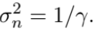
15
AWGN Additive White Gaussian Noise) :-
SNR = Ps/Pn=γ
Pn=Ps/SNR
where Ps = E{|x|²} is the mean power of the source and x is transmitted source
for bpsk .Ps=(-1²+1²)/2 =1
Noise added is
Uₛ~ N(0,1)

Slide 21
16
Decoding
Various methods for decoding :
1) Brute Force Method
2) Successive Cancellation Decoding
3) Successive Cancellation List Decoding

Slide 22
17
Brute Force Method
Step 1) Demodulate the noisy codeword obtained after doing BPSK and
adding AWGN.
Make every bit of the noisy codeword that is positive (≥0) as 0, and all the negative bits (<0) as 1.
Example :-
Consider a noisy codeword for N=4, [ -1.524, 0.421, 0.685, -1.221 ]
Demodulated noisy codeword : [ 1 , 0, 0, 1 ]

Slide 23
18
Step 2) Multiply the demodulated codeword with the inverse
of Gn, the output we get is our decoded codeword.
Consider demodulated codeword= d
decoded codeword = u
d
We know, c=u*G , where u is the transmitted codeword, c is the encoded codeword (before BPSK and AWGN).
Similarly d=u *G
We can find u from this equation.
N
ᵈ
N
ᵈ

Slide 24
19
Step 3) Compare u with u
ᵈ
Note: If c=d, then we are able to correctly reverse the effect of BPSK and AWGN and get back our encoded codeword.
Thus if u= u , then we have correctly decoded the codeword.
From this we can get our transmitted message by separating the frozen bits and message bits.
ᵈ
If not , we can find the number of errors by carrying out the xor operating between both of them and counting the number of 1's in the resulting sequence.

Slide 25
20
Advantages
1. Easy to implement
Disadvantages
Unreliable
It simply demodulates the noisy codeword without taking other factors into account , there is a chance that when noise generated has a magnitude greater than 1, it would lead to wrong bit being decoded.

Slide 26
21
Successive Cancellation Decoder
In this decoding process, bits of the received signal are decoded sequentially, starting with eliminating the least reliable ones. Each bit's decoding relies on information from previously decoded bits and the received signal
BPSK
+
AWGN
x1
u1
r1
G
x2
rᴺ
is belief of
xᴺ
u2
r2
xᴺ
uᴺ
N
x3
r3
is belief of
u3
u4
x4
r4

Slide 27
22
SC DECODER WITH N=2 subtree
x = [x1,x2] = [u1+u2,u2]
u1 = x1+x2
u2 = x2
belief (u1) = f(r1,r2) = sgn(r1).sgn(r2).min(|r1|,|r2|)
u1^ = 0 if belief(u1)>=0; u1^ = 1 if belief(u2)<0
g(r1,r2,b) =r2 + (1-2b)r1
Note - r1 refers to belief of x1 and r2 refers to belief of x2

Slide 28
23
SC DECODER WITH N=4 subtree
[r1 r2 r3 r4]
[u1^+u2^+u3^+u4^, u2^+u4^,
u3^+u4^ , u4^]
[f(r1,r3) , f(r2,r4)]
=
[r3,r4]
[L1 , L2]
=
[L3,L4]
[g(L1,L2,u1^)]
[f(L1,L2)]
[f(L3,L4)]
[g(L3,L4,u3^)]
u1
u2
u3
u4
f(L1,L2) = sgn(L1).sgn(L2).min(|L1|,|L2|)
g(L1,L2,b) =L2 + (1-2b)L1

Slide 29
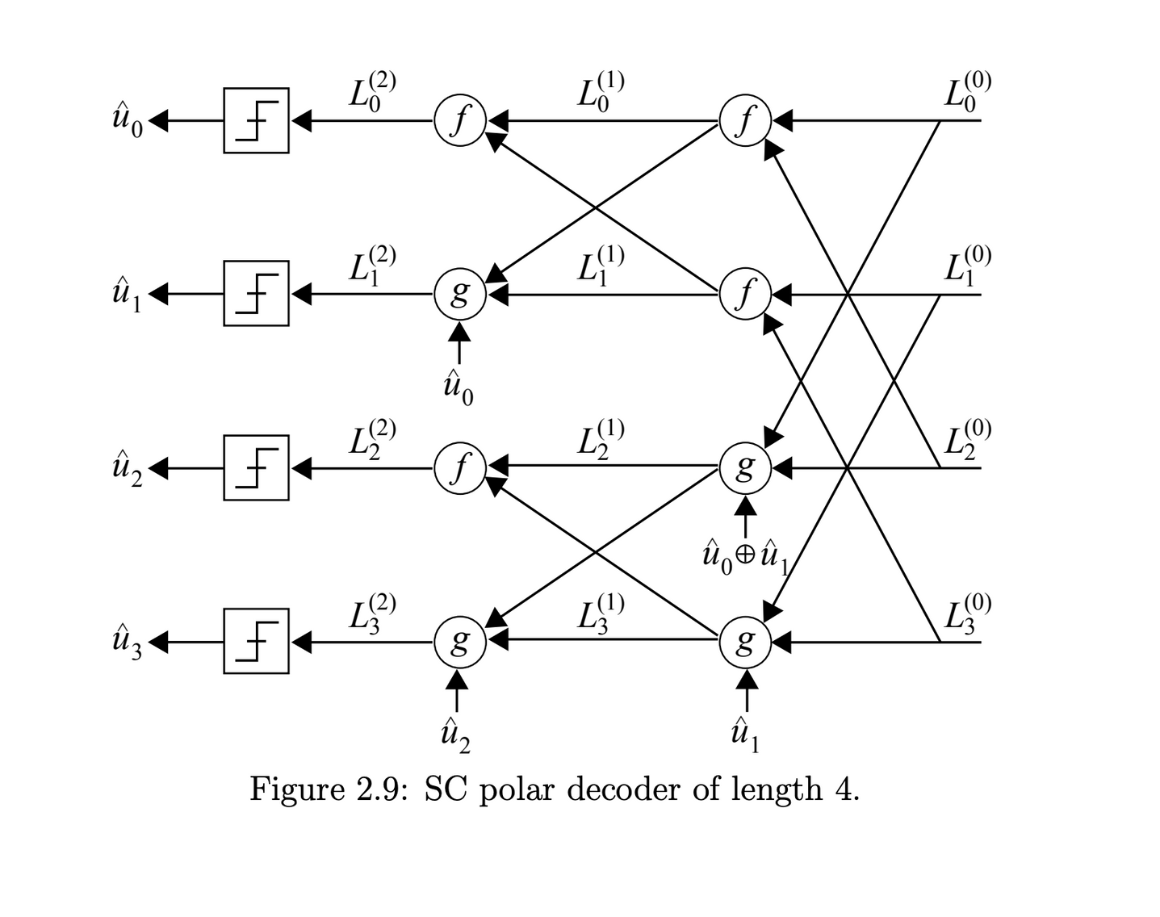
24
Image credit - Tahir, B. (2017). Construction and performance of polar codes for transmission over the AWGN channel [Diploma Thesis, Technische Universität Wien]. reposiTUm. https://doi.org/10.34726/hss.2017.50228

Slide 30
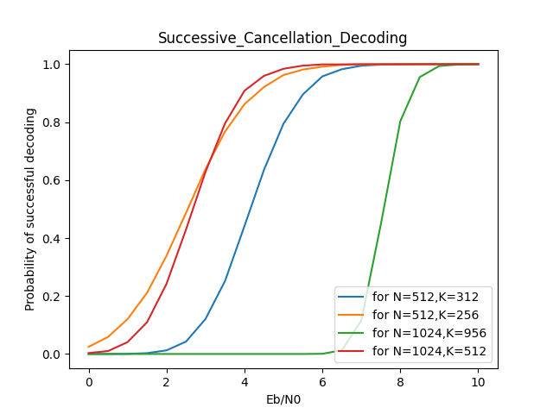
25
The above graph shows that at a very low value of Eb/N0 i.e. for the high value of Spectral Density of noise, the probability of successful decoding tends to zero, but as the value of Eb/N0 increases, the rate of increasing probability of successful decoding becomes exponentially high.
Also after a certain value of Eb/N0 , the probability of successful decoding becomes nearly equal to 1.

Slide 31
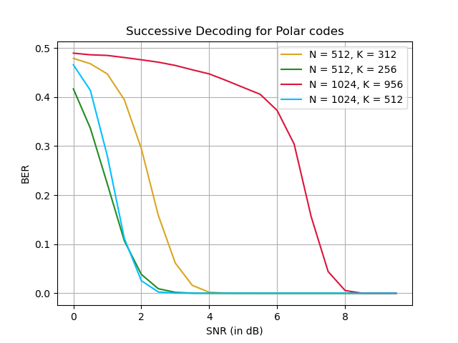
Observing for various values for (N,K)
26
The above graph shows bit error rate for various values of r = K/N. More is the ration of the redundant bits in the codeword transmitted , lesser are the possibilities of getting error in transmission for particular value of SNR.

Slide 32
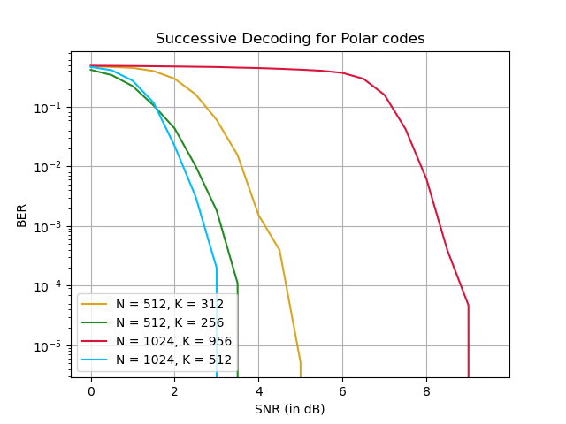
27
Same thing can be observed from taking the BER value in log scale also , same observation can be made on how drastically error reduces for a particular increase in Eb/N0.

Slide 33
28
Positives of SC-Decoder
Has comparatively lower time complexity for decoding, also due to sequential execution, it becomes easy to execute in real hardware systems.
As the block length increases up to an extent, then channels become very polarized, making channels either very good or very bad which leads to filtering and thus faster execution and high probability of successful decoding.
Predictable latency due to sequential execution as current progress can be seen to predict the total time for execution.
Drawbacks for SC-Decoder
A significant issue for the SC-decoder is that it decodes the current value as being dependent on the past bit value, any error in even a single bit can lead to a change in a message at the receiver end, so on compounding multiple errors this can lead to a drastic change in message bits.
Another major drawback is that the Sequential Decoding Algorithm is sequential in nature which leads to slower execution, so increasing the latency of the algorithm and very high execution time.

Slide 34
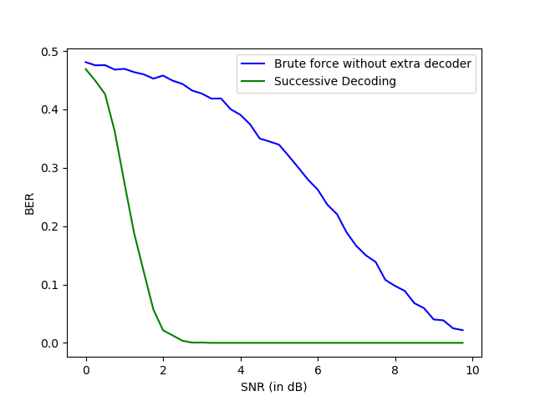
29
For N = 512 , K = 256
Direct Demodulation vs Successive Decoding Technique
NOTE - A SIGNIFICANT INCREASE IN PERFORMANCE IS NOTICED IN THE ABOVE GRAPH

Slide 35
Successive Cancellation List Decoding
30
Adding
CRC
Encode
BPSK +
AWGN
LIST
DECODE
CHECK
CRC
M
cwords
msg estimate
msg
cword
A
bits
K
bits
N
bits
K=A+L
(N,K) code
M : listsize
SC Decoding - any decoding error can propagate and later adversely affect the decoding of furthermore subsequent bits
List Decoding - Proposes a list of the most favorable codewords instead of one codeword, the number of codewords depending upon the requirement of the system.
To choose from the given list, there is padding of CRC bits used, namely called Cyclic Redundancy Test.
CRC is used only for Error-detection in codes, it though cannot be exploited to much help in error-correction.
Works similar to what Parity did in Single Parity Check (SPC) codes.

Slide 36
31
What is Cyclic Redundancy Check (CRC)??
CRC is a method used for error detection for Polar Codes data sequence transmitted over a channel.
This is done by adding some fixed length CRC bits padding at the end of message bits, thus information bits contain both message bits and CRC bits.
CRC check is done at both transmitter and receiver end such that the message bits’ binary values when using a coefficient for a polynomial then polynomial formed by CRC bits as coefficient divides it for remainder zero.
If the remainder obtained at the receiver side does not yield zero, then it means that error has a role to play in the received message.

Slide 37
32
How does CRC WORK ??
Let the data be 1001101 and the binary equivalent of the generic polynomial is 1011. On the sender side, the remainder can be found using binary division as follows.
The remainder of the above division is 101. This remainder is appended to the data to create the signal which will be sent to the receiver. The signal is 1001101101.
Example Credit-
https://www.scaler.com/topics/crc-program-in-c/

Slide 38
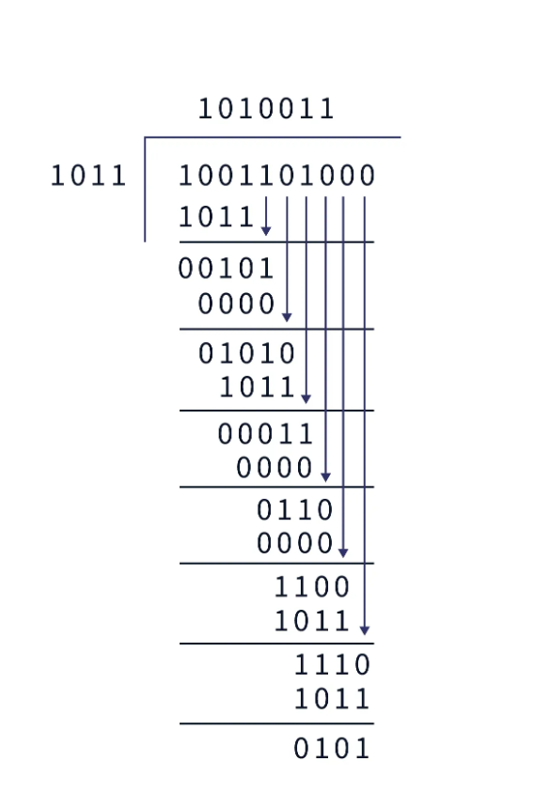
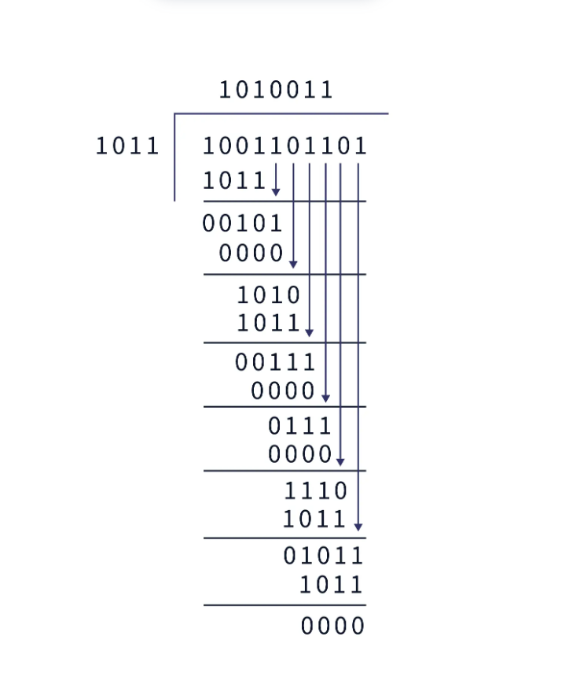
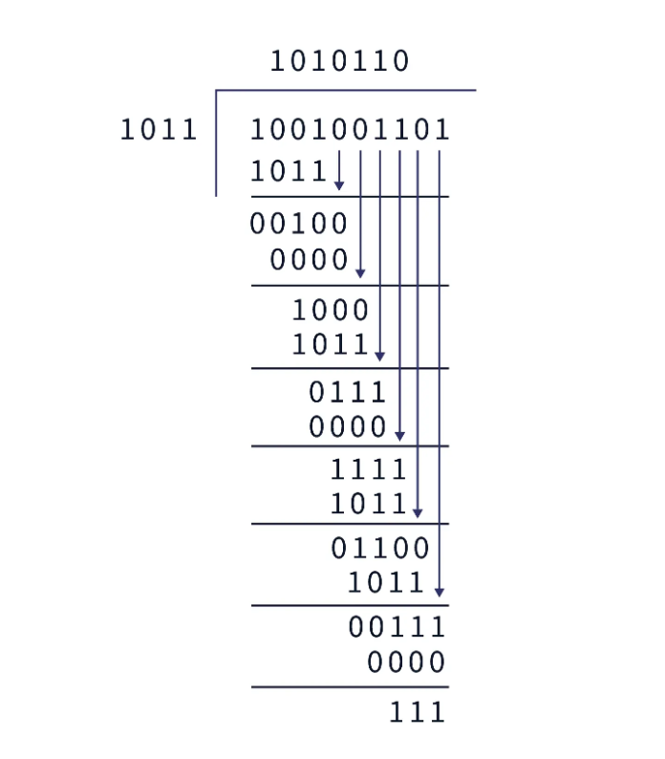
33
As the remainder is 111, we can assure that there is an error in the message.
Example Credit-https://www.scaler.com/topics/crc-program-in-c/

Slide 39
34
Path Metrics , Decision Metrics
In context of Succession List Decoding , parameters like Path Metrics , Decision Metrics have an important role to play to decide which out of all generated codewords is most efficient and close to the message transmitted and contains least of all errors.
Decision Matric basically means belief of the node.
Path metric represents the sum of all the decision metrics along in that path
How to produce multiple codewords ?
Consider both decisions for each bit and assign the decision metric (DM) for it.
If L(UI)>=0, ui^ = 0 has decision metric DM = 0; and ui^=1 will have decision metric DM = | L(ui) |;
If L(UI)<0, ui^ = 1 has decision metric DM = 0; and ui^=0 will have decision metric DM = | L(ui) |;
For frozen bits also, when we take a decision against the belief then we need to have DM = | | L(ui) |;
Path metric is the sum of decision metrics.
Path Metric thus represents total penalty cost for corresponding particular codeword , lower the Path metric , better is the probability of codeword being correct.

Slide 40
How Successive List Decoding Works ?
35
Main abstract of this method is that we perform Successive decoding paralelly for nL decoders and calculate path metrics for each generated codeword and when number of codewords exceen nL , then we prune the branches for codewords with highest path metrics and end up getting nL codewords with lowest path metric and highest probability of success amongst others.
All of the nL codewords might not be correct but at the end of traversal , we check for Cyclic Redundancy Check in all nL codewords and consider the one which has passed CRC check and has lowest path metric.
In some cases it might occur that none of them actually passes CRC check then , we filter them on bases of path metric only and consider the one with lowest path metric as final decoder codeword.
Figure represented on next page actually explains for temporary list sized growth for branches showing generation and reduction for actual nL codewords up to a extent.

Slide 41
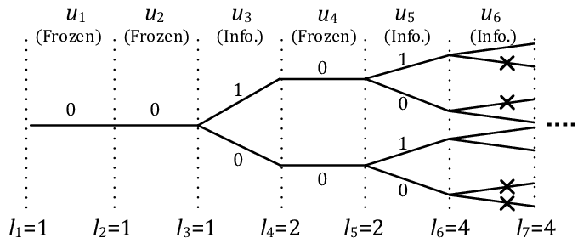
36
Temporary List size growth in Successive List Decoding with nL = 4
Image credits - Kim, Jong-Hwan & Kim, Sang-Hyo & Jang, Ji-Woong & Kim, Young-Sik. (2017). Low Complexity List Decoding for Polar Codes with Multiple CRC Codes. Entropy. 19. 183. 10.3390/e19040183.

Slide 42
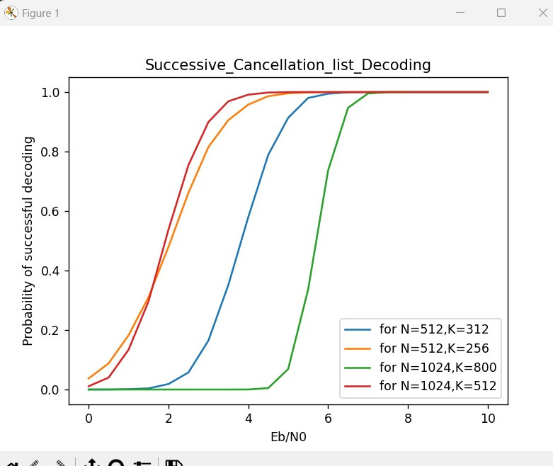
37
Performance of a Successive List Decoder for various valuesof N and k
All the positives for the Successive Cancellation Decoder also hold for the List Decoder. Still, over larger values, we can observe the difference in the performance of the list decoder vs sc decoder.
Another observation holds that as the value of N increases in ratio to K, the probability of success increases.

Slide 43
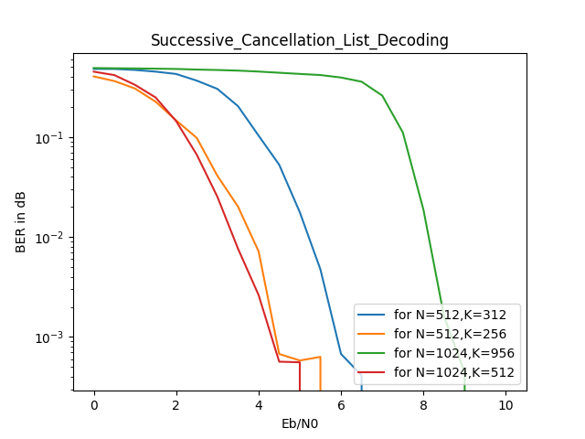
38

Slide 44
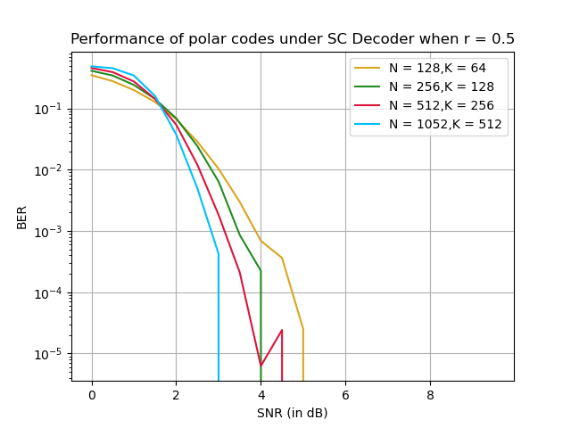
39
Performace of List Decoder under r = 0.5
For N = 64 , K = 39

Slide 45
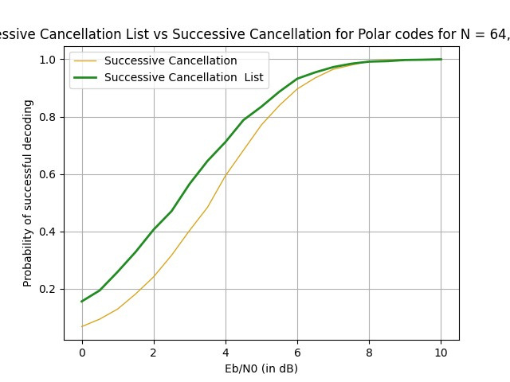
Performance Improvement in moving to List Decoder vs SC-Decoder
40
For N = 64 , K = 39
As we can observe from the above plot , we can have a significant change in performance at even low values of SNR over a number of simulations and this can be considered as a significant improvement in channel decoding perspective for error-correcting codes

Slide 46
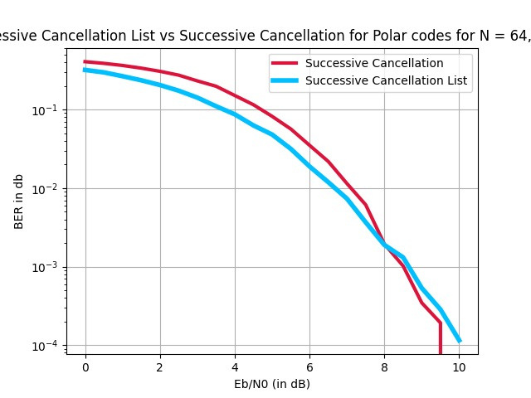
Performance Improvement in moving to List Decoder vs SC-Decoder
41
For N = 64 , K = 39
The above plot shows a bit error rate comparison for SC-Decoder and List Decoder for multiple simulations, as we can observe the bit error rate is quite lower in List Decoder than in SC-Decoder which should also be the case.

Slide 47
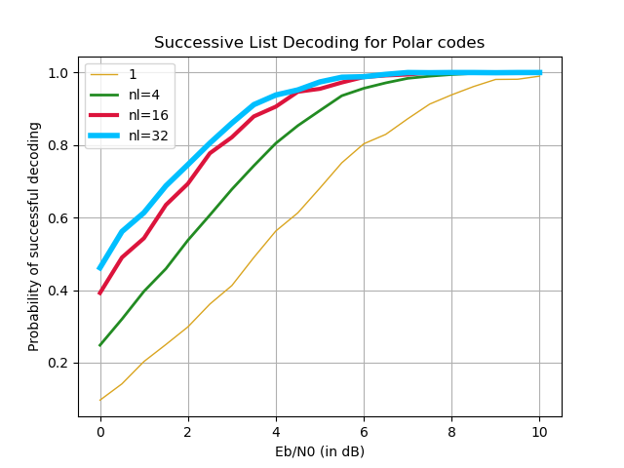
Performance Improvement in List Decoder when increased value of number of generated codewords
42
For N = 64 , K = 39

Slide 48
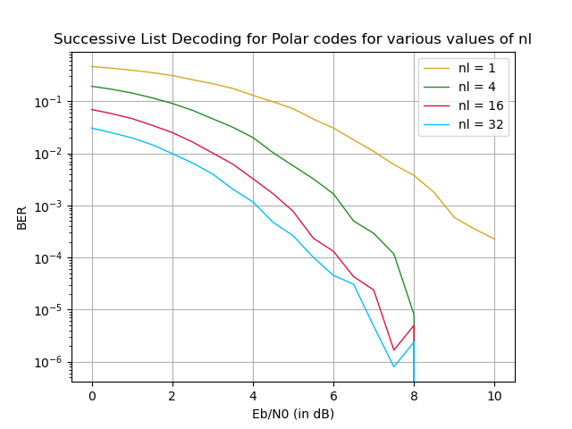
For N = 64 , K = 39
For N = 64 , K = 39

Slide 49
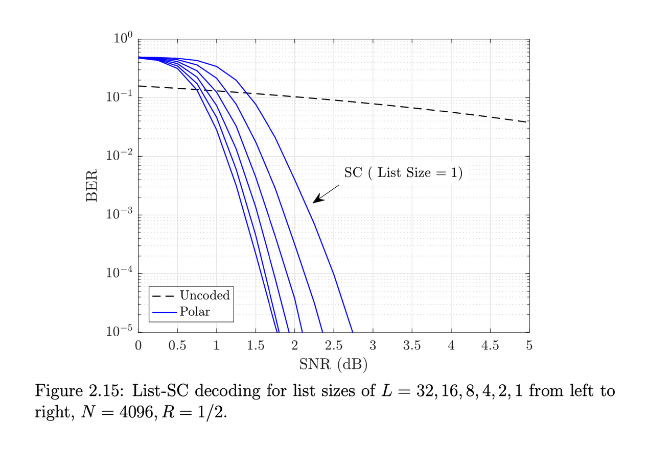
43
The above images show the difference it would make for the efficiency of the received bit when we increase nL i.e. the maximum number of codewords that can be simultaneously generated.
As we increase the number of decoders we increase in recognizing the margin of error and try to eliminate most of them by having a greedy approach when we need to select branches to prune for generating codewords.
Image credit - Tahir, B. (2017). Construction and performance of polar codes for transmission over the AWGN channel [Diploma Thesis, Technische Universität Wien]. reposiTUm. https://doi.org/10.34726/hss.2017.50228

Slide 50
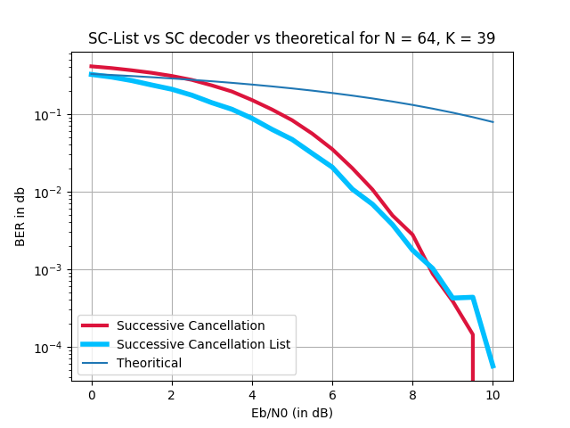
Theoretical BER with BER for SC-Decoder and List Decoder
44

Slide 51
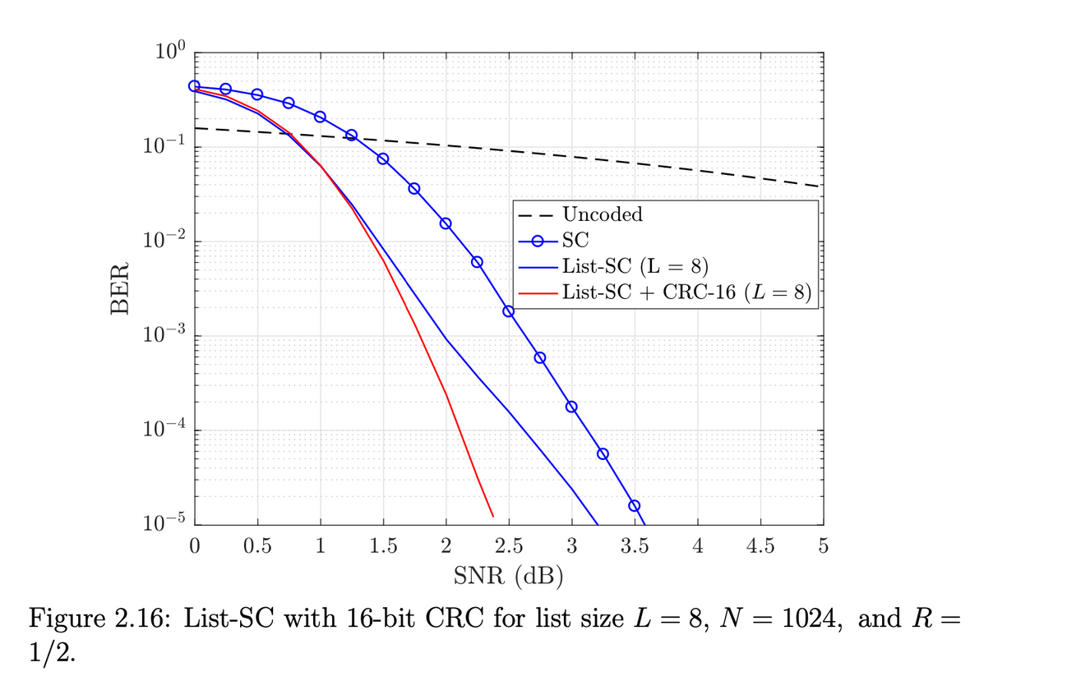
45
The above shows the difference and gradual increase in efficiency as we move ahead in the methods we used for decoding the polar encoding done at the channel side.
As we can observe the difference it makes when we use the List-Sc decoder in place of the SC-Decoder and when we use the CRC bits for error detection we can definitely observe an upgrade when simulated over a long keyword for a high number of simulations.
Image credit - Tahir, B. (2017). Construction and performance of polar codes for transmission over the AWGN channel [Diploma Thesis, Technische Universität Wien]. reposiTUm. https://doi.org/10.34726/hss.2017.50228

Slide 52
Thank you

